Slide 1
Using the Normal Ogive to Derive an Item Characteristic Curve
This section represents an elaboration/illustration of the narrative found in Lord & Novick (1968, pp. 370-371) and in Thissen & Orlando (2001, pp. 84-87).

Slide 2
Lord & Novick (1968)
In their classic book, L&N introduce the normal ogive IRT model as
They write:
[The equation] may be taken simply as a basic assumption, the utility of which can be investigated for a given set of data (albeit with considerable difficulty). Alternatively [this equation] can be inferred from other, possibly more plausible assumptions. We shall outline one way of doing this, a way that some theorists find interesting and others do not. (Lord & Novick, 1968, p. 370)

Slide 3
It Starts with a Test and an Item
Let’s say the first item on a math test for 6th graders asks
A penny is tossed 20 times. Which of the following is most likely to be the number of times heads came up?
A. 0
B. 2
C. 5
D. 8
E. 15
This item is trying to find out whether the student has a basic understanding of probability.

Slide 4
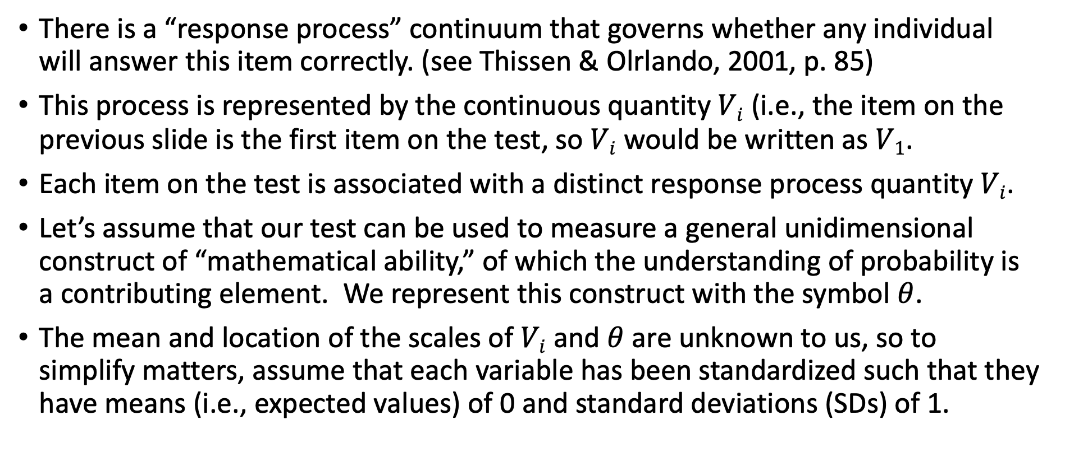
Now Build a Model
There is a “response process” continuum that governs whether any individual will answer this item correctly. (see Thissen & Olrlando, 2001, p. 85)
This process is represented by the continuous quantity $Vi$ (i.e., the item on the previous slide is the first item on the test, so $Vi$ would be written as $V1$.
Each item on the test is associated with a distinct response process quantity $Vi$.
Let’s assume that our test can be used to measure a general unidimensional construct of “mathematical ability,” of which the understanding of probability is a contributing element. We represent this construct with the symbol $θ$.
The mean and location of the scales of $Vi$ and $θ$ are unknown to us, so to simplify matters, assume that each variable has been standardized such that they have means (i.e., expected values) of 0 and standard deviations (SDs) of 1.

Slide 5
A Regression Equation
The latent variable underying any single item on the test can be related with the linear regression equation
where ρ_{i} represents the correlation between V_{i} and θ (recall that the slope of a regression of one standardized variable onto the other is just the correlation coefficient); and ε_{i} represents a random error term.
We assume that ε_{i} ~ N(0, 1), and by construction (just as in CTT!), the latent variables ε_{i} and θ are independent.
The parameter ρ_{i} represents a biserial correlation (as opposed to a point-biserial correlation).

Slide 6
A (Hypothetical) Visualization for 500 students on item 1 when ρ₁ = 0.70

Slide 7
Notes
The regression line predicts the conditional mean of V_{i} given θ. An equivalent way to write this would be
The amount that any single prediction is likely to be off for any given respondent is quantified by the root mean square error (RMSE), which will be
The pdf for V_{i} given θ is assumed to be normally distributed (no such assumption is needed for unconditional distributions of V_{i} or θ)

Slide 8

Item with a Threshold at $Vi =τ_{i}=1$
How would we figure out the probability of someone having V_{i} over 1 for different values of θ?
Notes:
This is how I generated the data for this plot in R:
library(MASS)
sigma<-matrix(c(1,.7,.7,1),2,2)
mu<-c(0,0)
bvn <- mvrnorm(n=500, mu = mu, Sigma = sigma )
plot(bvn,xlim=c(-3,3),ylim=c(-3,4),xlab="Theta",ylab="V")
abline(h=1,col="red")

Slide 9
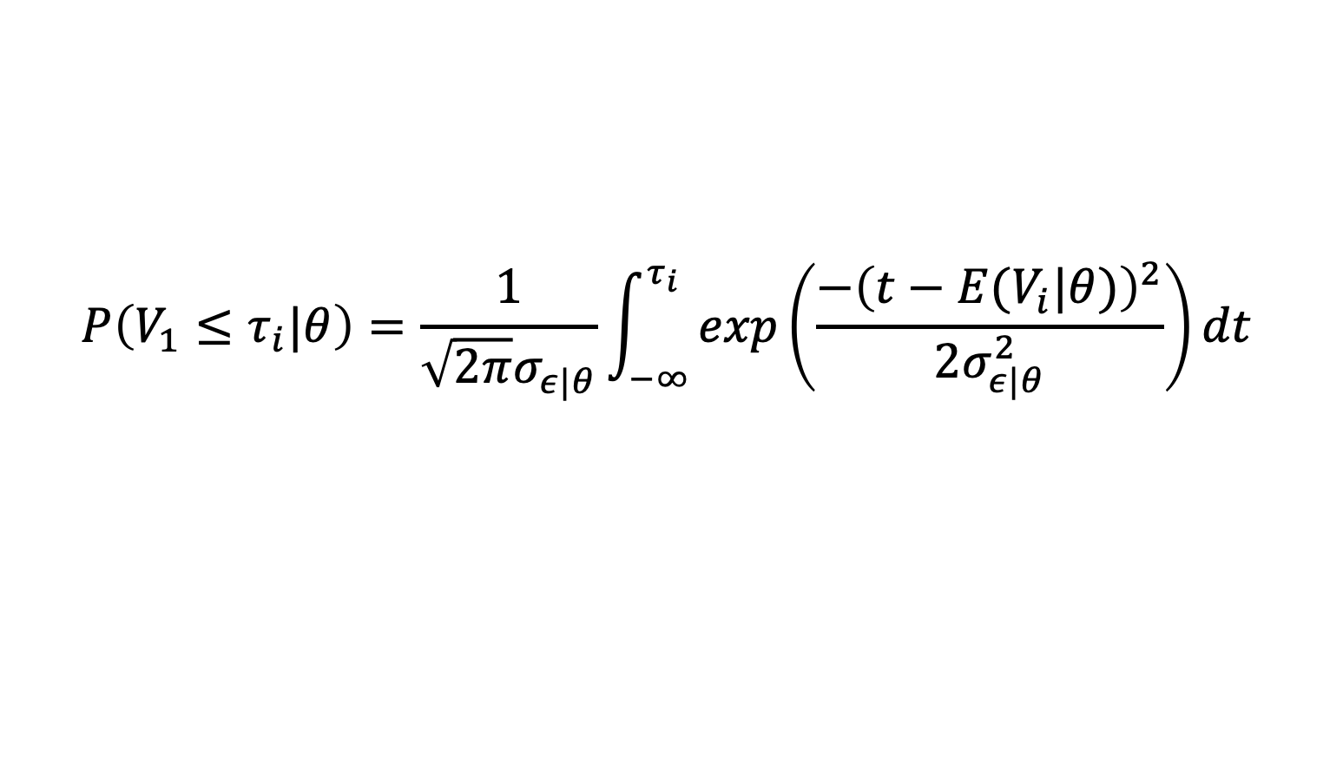

Use the Normal Cumulative Distribution Function (CDF)
$$P\left(V_{1}≤τ_{i}|θ\right)=\frac{1}{\sqrt{2π}σ_{ε|θ}}\int_{−∞}^{τ_{i}}{exp\left(\frac{−{\left(t−E(V_{i}|θ)\right)}^{2}}{2σ_{ε|θ}^{2}}\right)}dt$$
Notice that this is a conditional cdf (give you a probability conditional on a specific value of $θ$
If you are not familiar with the normal cdf (also known as the normal ogive) and want to understasnd it better, please see http://www.r-bloggers.com/normal-distribution-functions/ which shows how you can use it in R, and also see my ppt slides “2_Background_Statistical_Concepts.pptx”

Slide 10

When $θ=−1$
So if you plug these values into the cdf on previous page it follows that
$$P\left(V_{1}>1\right|θ=−1)=1−P(V_{1}≤1\left|θ=−1\right)=.01$$
> 1-pnorm(1, mean=-.7, sd=.71)
[1] 0.008324558

Slide 11

$P(V≥1)$ when $θ$ $= −1$ $is .01$

Slide 12

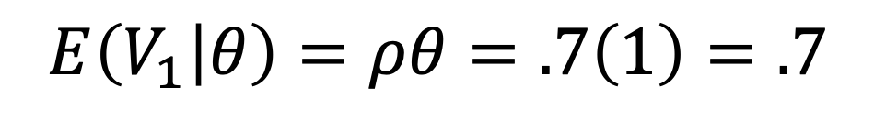
What about when $θ =1$?
$$E\left(V_{1} | θ\right)=ρθ=.7\left(1\right)=.7$$
So if you plug these values into the cdf on previous page it follows that
P$\left(V_{1}>1 | θ=1\right)=1−P\left(V_{1}≤1 | θ=1 \right)=.34$
1-pnorm(1, mean=.7, sd=.71)
[1] 0.3363172

Slide 13

$P(V>1)$ when $θ=1$is .34

Slide 14

What about when $θ = 2$?
So if you plug these values into the cdf on previous page it follows that
> 1-pnorm(1, mean=1.4, sd=.71)
[1] 0.713412

Slide 15

$P(V>1)$ when $θ=2$ is .72

Slide 16
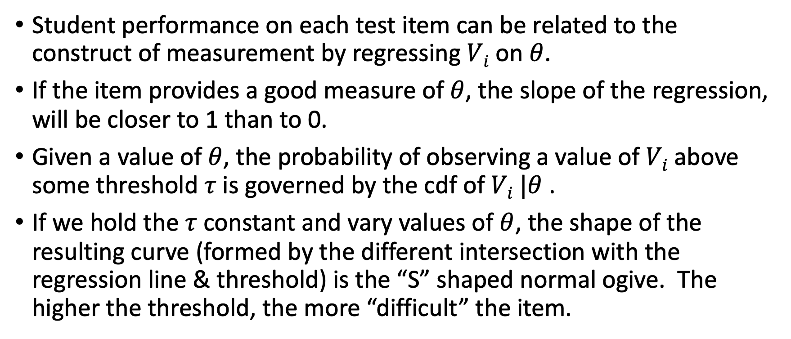
The Story So Far
Student performance on each test item can be related to the construct of measurement by regressing $Vi$ on $θ$.
If the item provides a good measure of $θ$, the slope of the regression, will be closer to 1 than to 0.
Given a value of $θ$, the probability of observing a value of $Vi$ above some threshold $τ$is governed by the cdf of $Vi |θ$ .
If we hold the $τ$ constant and vary values of $θ$, the shape of the resulting curve (formed by the different intersection with the regression line & threshold) is the “S” shaped normal ogive. The higher the threshold, the more “difficult” the item.

Slide 17
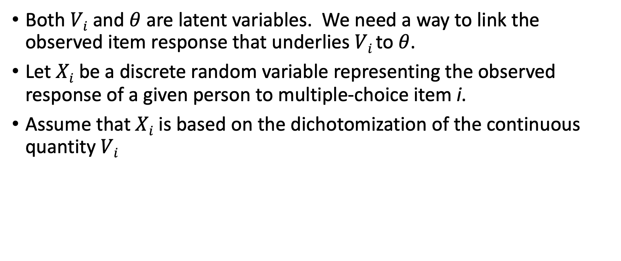
From Latent to Observed
Both $Vi$ and $θ$ are latent variables. We need a way to link the observed item response that underlies $Vi$ to $θ$.
Let $Xi$ be a discrete random variable representing the observed response of a given person to multiple-choice item i.
Assume that $Xi$ is based on the dichotomization of the continuous quantity $Vi$

Slide 18
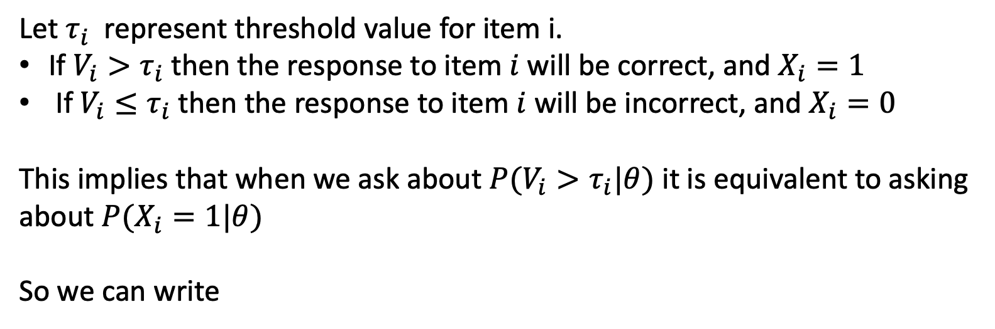
Dichotomization Rule
Let $τ_{i}$ represent threshold value for item i.
If $V_{i}>τ_{i}$then the response to item $i$ will be correct, and $X_{i}=1$
If $V_{i}≤τ_{i}$then the response to item $i$ will be incorrect, and $X_{i}=0$
This implies that when we ask about $P(V_{i}>τ_{i}|θ)$ it is equivalent to asking about $P(X_{i}=1|θ)$
So we can write

Slide 19
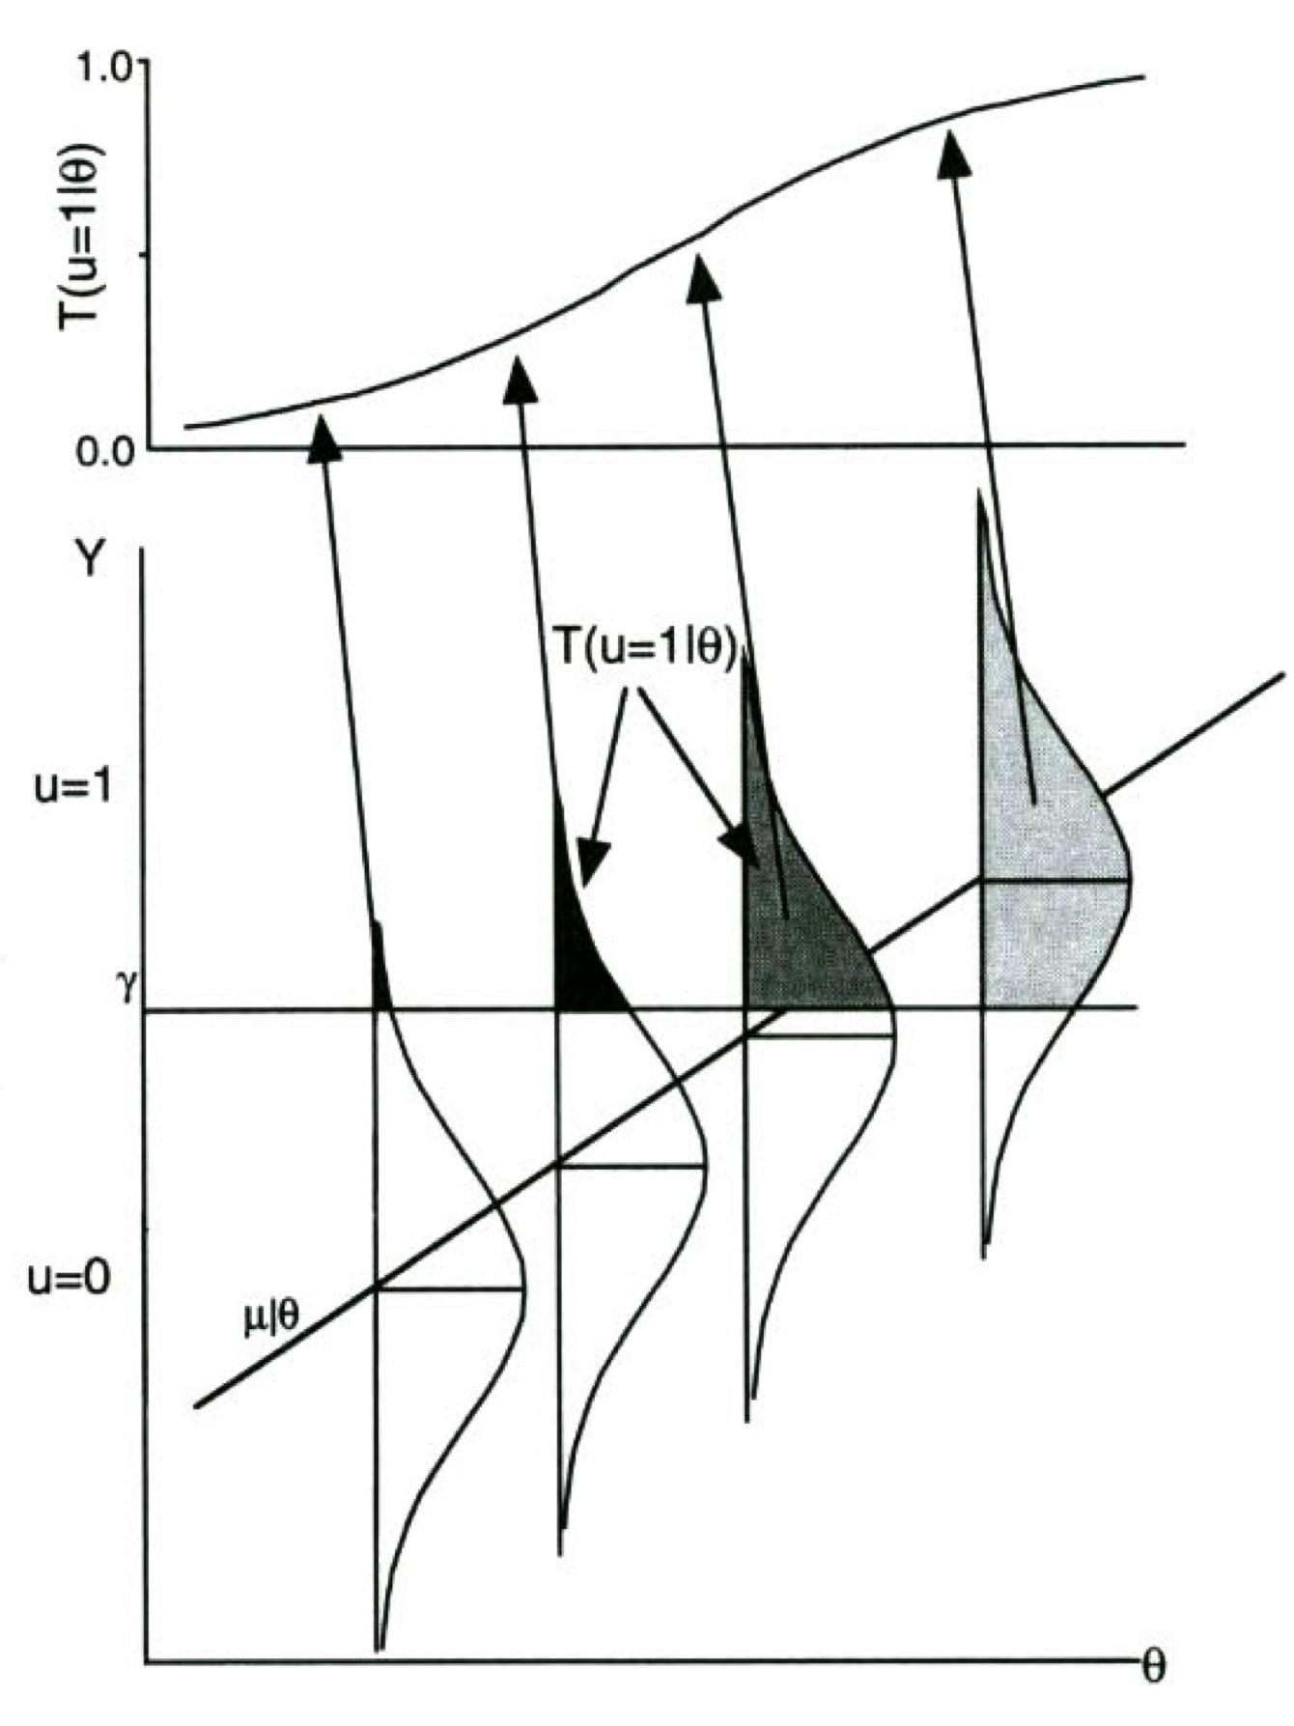
Putting this Together
Correlation (ρ_{i})
Threshold (τ_{i})
Source: Thissen & Orlando (2001), p. 86

Slide 20
Two Parameter Normal Ogive ICC
where
So given the present example if $ρi = 0.7$ and $τi = 1$

Slide 21
Plot of the ICC for this Item in R
theta<-seq(from=-4,to=4,by=.1)
a<-1
b<-1.43
cum2plno<-pnorm(a*(theta-b))
plot(theta, cum2plno, col="black", xlab="", ylab="Cumulative Probability",
type="l",lwd=2, cex=2, main="", cex.axis=.8)

Slide 22
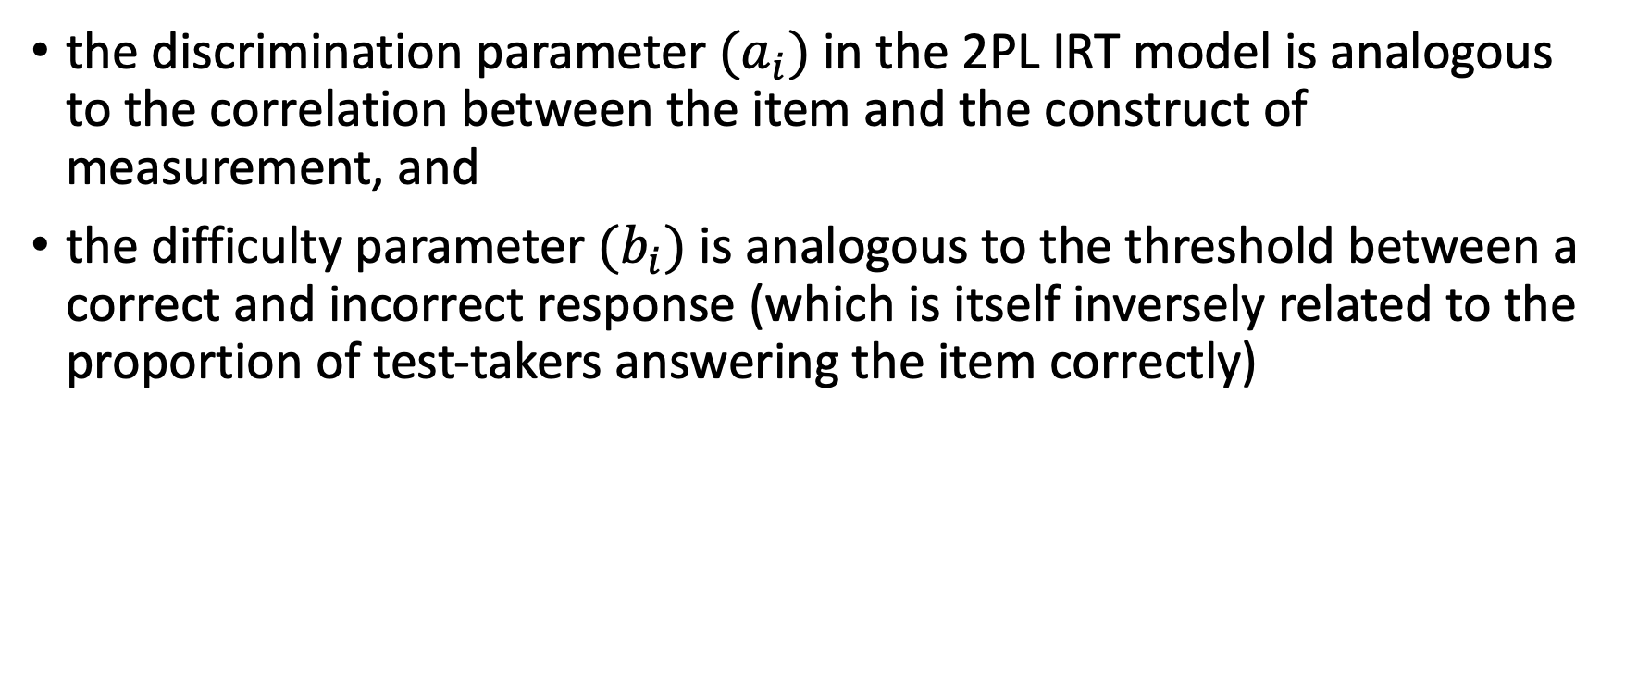
This explains why
the discrimination parameter $(a_{i})$ in the 2PL IRT model is analogous to the correlation between the item and the construct of measurement, and
the difficulty parameter $(b_{i})$ is analogous to the threshold between a correct and incorrect response (which is itself inversely related to the proportion of test-takers answering the item correctly)

Slide 23
From IRT Parameters back to Factor Analytic Parameters
Note: these relationship only hold if theta is normally distributed and there is no guessing on items.
Threshold of item continuum a person needs to be at or above to answer item correctly. Not a parameter of interest in a linear FA model.
Biserial Correlaton between item and test construct. Equivalent to a factor loading in a linear factor analysis model.

Slide 24
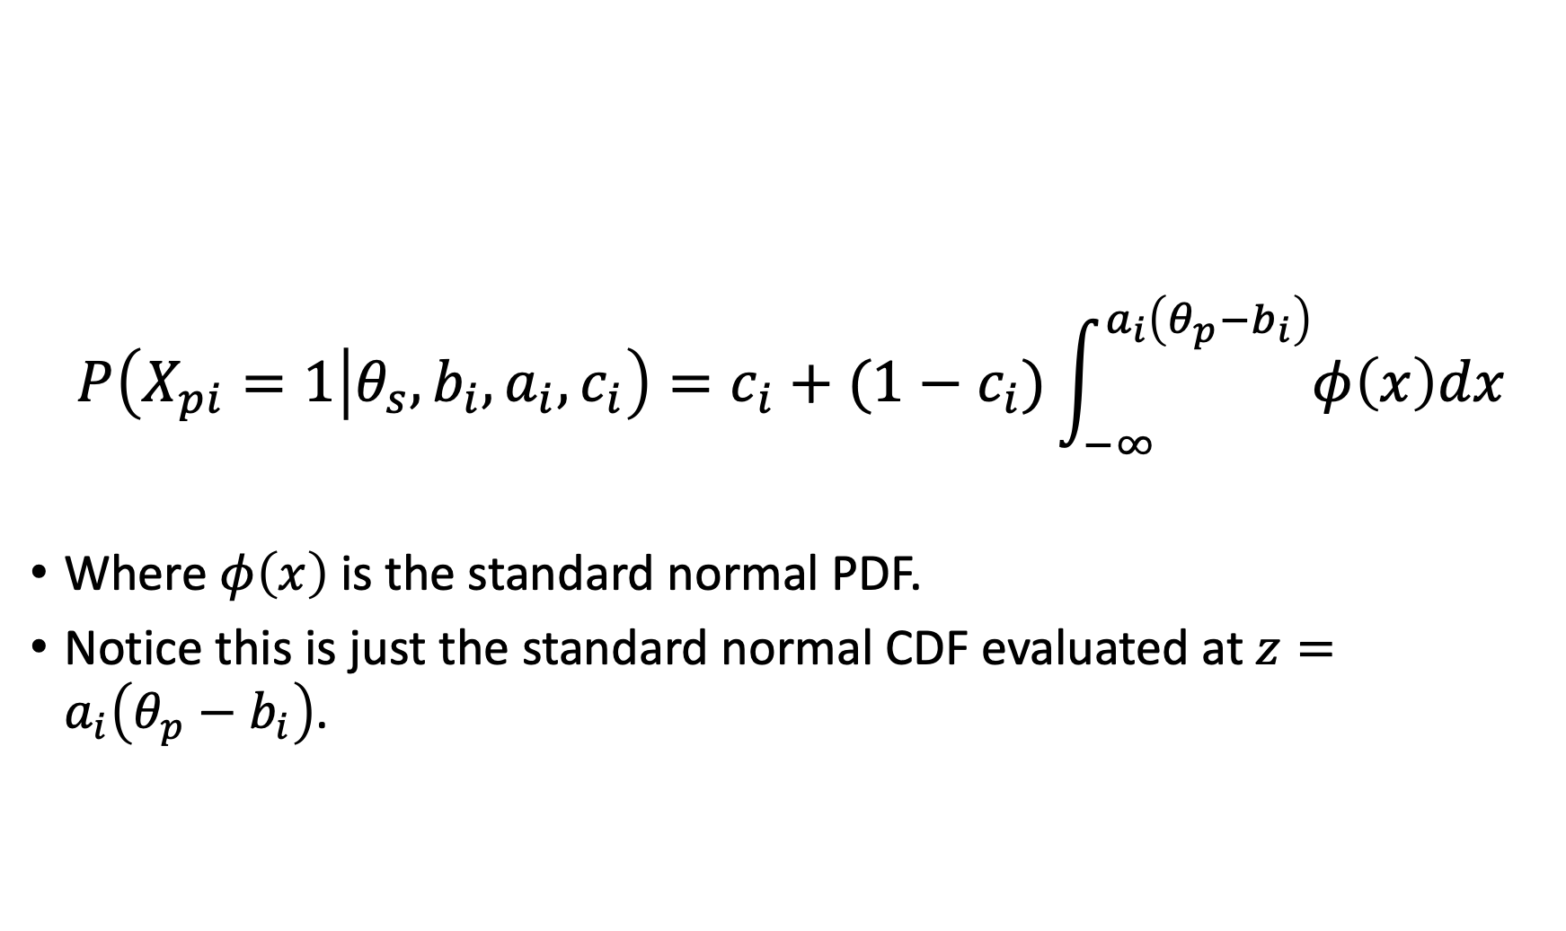
The Three Parameter Normal Ogive Model
$$P\left(X_{pi}=1 | θ_{s}, b_{i},a_{i},c_{i}\right)=c_{i}+(1−c_{i})\int_{−∞}^{a_{i}\left(θ_{p}−b_{i}\right)}{φ\left(x\right)dx}$$
Where $φ\left(x\right)$ is the standard normal PDF.
Notice this is just the standard normal CDF evaluated at $z=a_{i}\left(θ_{p}−b_{i}\right)$.

Slide 25
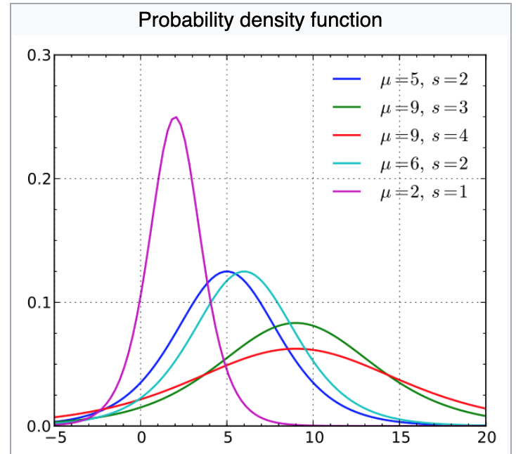
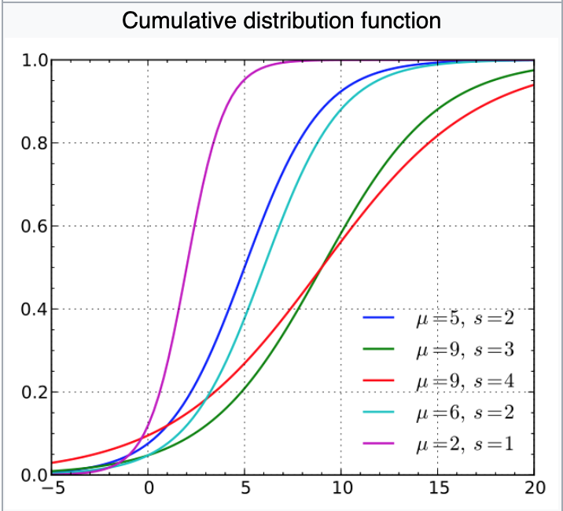
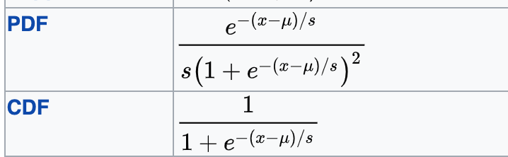
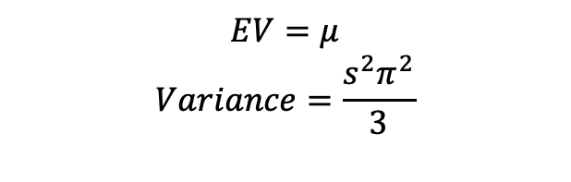
Logistic PDF and CDF
$$EV=μ$$
$$Variance=\frac{s^{2}π^{2}}{3}$$
https://en.wikipedia.org/wiki/Logistic_distribution

Slide 26
Applying the Logistic PDF and CDF in R
ldensities<-dlogis(xseq,location=500,scale=100)
lcumulative<-plogis(xseq, location=500,scale=100)

Slide 27
Logistic CDF as IRF

Slide 28
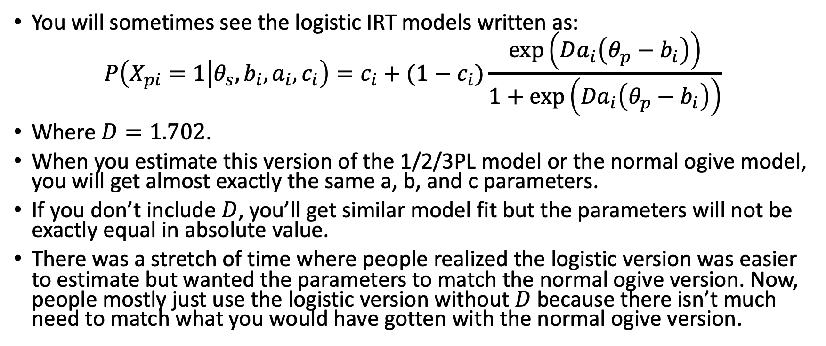
The Logistic vs. Normal Ogive IRT Models
You will sometimes see the logistic IRT models written as:
$$P\left(X_{pi}=1 | θ_{s}, b_{i},a_{i},c_{i}\right)=c_{i}+(1−c_{i})\frac{\exp\left(Da_{i}\left(θ_{p}−b_{i}\right)\right)}{1+\exp\left({Da}_{i}\left(θ_{p}−b_{i}\right)\right)}$$
Where $D=1.702$.
When you estimate this version of the 1/2/3PL model or the normal ogive model, you will get almost exactly the same a, b, and c parameters.
If you don’t include $D$, you’ll get similar model fit but the parameters will not be exactly equal in absolute value.
There was a stretch of time where people realized the logistic version was easier to estimate but wanted the parameters to match the normal ogive version. Now, people mostly just use the logistic version without $D$ because there isn’t much need to match what you would have gotten with the normal ogive version.

